Slide 1

Supplementary Live Session Module 1
MET CS 682 – Spring , 2024
Information Systems
Analysis and Design
Professor Dawson Williams
1/6/2024

Slide 2
Agenda
Introductions & Course Overview
Deliverables & Grading Structure
Live Classrooms logistics
Information Systems
Systems Requirements

Slide 3
Introductions - Our Teaching Team
Dawson Lee Williams
Adam Arakelian
Jennifer Pixley

Slide 4
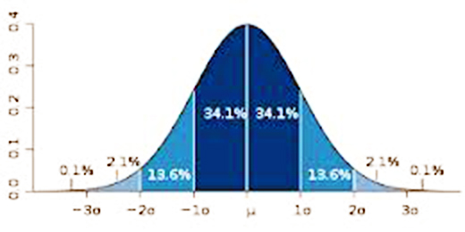
Normal Distribution Curve
When we talk about excellence, we are discussing the +3 Std. Dev. From the mean

Slide 5
What is System Analysis?
The course focuses on modern methods of information system Analysis and Design.
System analysis – the study of a business problem domain to recommend improvements (existing system) and specify the business requirements and priorities for the solution (that information technology can satisfy).
(Whitten, 2007)
Who will use the system.
What the system will do.
How the system will be constructed (high level).

Slide 6
What is System Design?
The course focuses on modern methods of information system Analysis and Design.
System design – the specification or construction of a technical, computer-based solution for the business requirements identified in a system analysis.
(Whitten, 2007)
How the system will be constructed.
Blueprints (UML Design)
How the system will operate and integrate.
Software & Hardware

Slide 7
Analysis and Design of Systems
Why it matters….
“The hardest single part of building a software system is deciding precisely what to build. No other part of the conceptual work is as difficult as establishing the detailed technical requirements, including all the interfaces to people, to machines, and to other software systems. No other work so cripples the resulting system if done wrong. No other part is more difficult to rectify later.”
Fred Brooks, Essay on The Essence and Accident in Software Engineering 1986

Slide 8
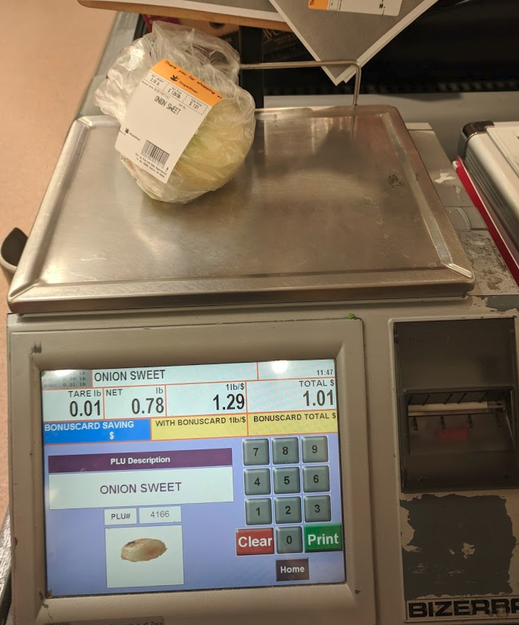
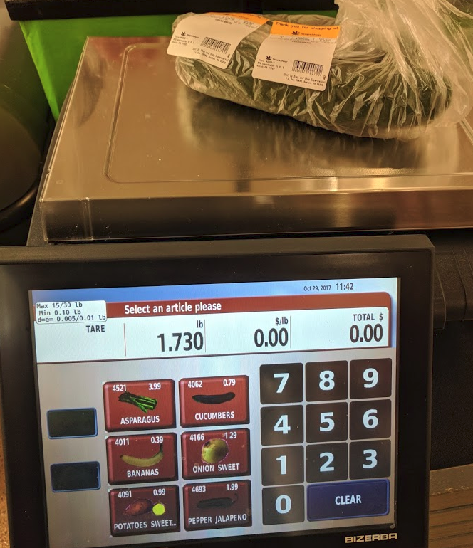
Analysis and Design of Systems
Why it matters….
https://www.bizerba.com/en_us/products/product-overview.html
Where is the Print button???

Slide 9
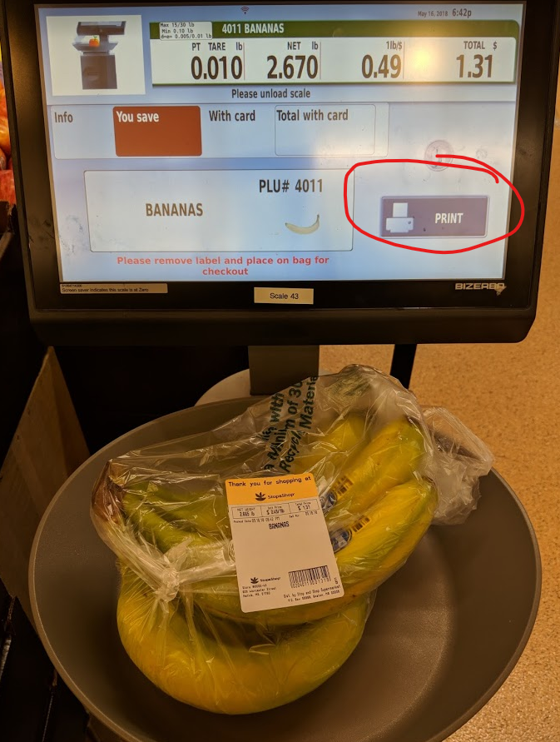
Analysis and Design of Systems
It was fixed!!!

Slide 10
Main Phases of Software Process
Requirements Analysis
Specification of application
Design
Specification, Design of parts
Implementation
Coding, Installation, Integration
Testing
Does it do what it’s supposed to
Maintenance
Defect repair, minor modifications/extensions

Slide 11
Systems Analyst & Systems Designer
You will be wearing two hats!
Systems Analyst (Weeks 1-3)
Determine how to solve business problems & realize opportunities to improve systems/processes.
System Designer (Weeks 4-6)
Technical specialist- translates business requirements and constraints into technical solutions.

Slide 12
Creating your Analysis & Design Toolbox
Weekly modules:
Module 1 – Introduction to Process & Systems Analysis
Module 2 – Management of Systems Analysis (Waterfall, RAD, Agile) & Risk Management
Module 3 –System and Requirements Analysis
Module 4 – System Modeling (UML Models)
Module 5 – Modeling, Design Goals, Architecture
Module 6 – Detailed Design Principles

Slide 13
We are amazed at what you do!
You will learn a lot in 6 weeks!
We will support you every step of the way.
Please ask for help
if you are stuck!
http://broadpeakpartners.com/drinking-directly-from-the-big-data-firehouse/

Slide 14
Normal Week – Schedule of Live Classrooms
Tuesday nights 8:00pm-10:00 pm ET
Concepts to start you thinking about the week’s topics
Focus on concepts related to assignments
Wednesday nights 8:00pm -9:00 pm ET
discussing specifics of the assignment: approaches/examples
Saturday at 1:00PM Noon ET
Review your questions on weekly material and assignment/project
Last Minute questions
All Live classrooms will be recorded and posted as soon as possible

Slide 15
Course Deliverables
Weekly Assignment/Project: 60% of the grade.
Allows you to learn, research, think about and apply the weekly material.
Please review note on Lateness in the Syllabus.
“Draft” Assignment 6% of the grade
Early check-in of your assignment towards Technical Soundness, Feedback (On Track=1 | Off Track=0)
Drafts have multiple parts, you may get .5 on track for one of the parts.
Final Exam: 34% of the grade.
Similar in style to the assignments.
Discussions are Optional

Slide 16
Assignment Grading Rubric
Criteria | D | C- | C+ | B- | B+ | A
i Clarity | Disorganized or hard-to-understand |  | Satisfactory but some parts of the submission are disorganized or hard to understand | Generally organized and clear | Very clear, organized and persuasive presentation of ideas and designs | Exceptionally clear, organized and persuasive presentation of ideas and designs
ii Technical Soundness | Little understanding of, or insight into material technically |  | Some understanding of material technically | Overall understanding of much material technically | Very good overall understanding of technical material, with some real depth | Excellent, deep understanding of technical material and its inter-relationships
iii Thoroughness & Coverage | Hardly covers any of the major relevant issues |  | Covers some of the major relevant issues | Reasonable coverage of the major relevant area | Thorough coverage of almost all of the major relevant issues and researched where appropriate | Exceptionally thorough coverage of all major relevant issues and researched where appropriate
iv Relevance | Mostly unfocused | Focus is off topic or on insubstantial or secondary issues | Only some of the content is meaningful and on topic | Most or all of the content is reasonably meaningful and on-topic | All of the content is reasonably meaningful and on-topic | All of the content is entirely relevant and meaningful

Slide 17
Reviewing your work
The point is not whether we agree with you but whether you have stated solutions clearly, with appropriate technical soundness and relevance and explained them thoroughly.
When you receive feedback that is not clear to you - discuss with your facilitator.
That is part of the learning process!

Slide 18
Executive Writing – Module 0
An Important part of this course is improving your ability to communicate requirements and design through writing.
Effective writing is central to being successful in this course and also within Information Technology.
Review Executive Writing – Module 0 for a 1 hour video on improving your writing skills.

Slide 19
Academic Conduct Policy
Be very mindful of Plagiarism.
We take this very seriously.
The solutions must be your own.
Any solution found to be plagiarized -submitting someone else's work as your own will be reported to Academic Conduct office and a grade penalty.
Using a “friend’s”/assignment you got online to help complete your own is also considered plagiarism will be reported to Academic Conduct office a grade penalty.
Sharing an assignment with someone else may result in a grade penalty.
The syllabus explains this in detail.
We use tools to check for plagiarism within the assignments and Term Project.
Please review official conduct code -http://www.bu.edu/met/metropolitan_college_people/student/resources/conduct/code.html

Slide 20

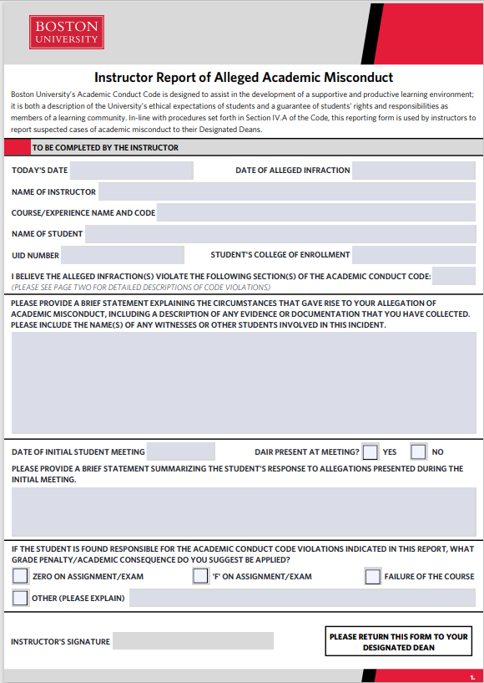
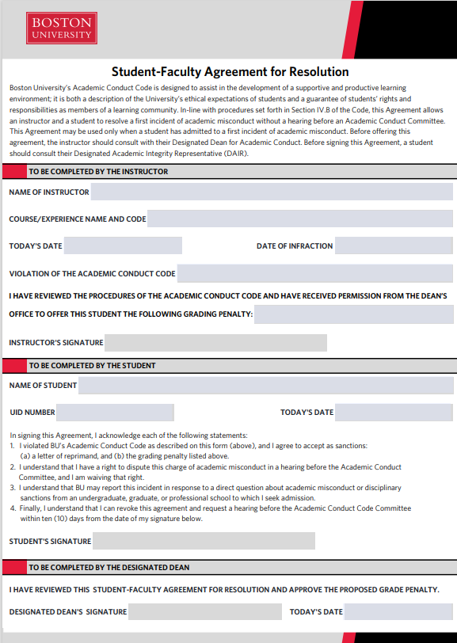
Academic Conduct Process

Slide 21
Crediting Sources Tutorial Self-Assessment
Please complete the Crediting Sources Tutorial & Self Assessment by end of this week
This ten-question assessment covers the basics of crediting sources in your works. You can take this assessment as often as you like.
There is extensive feedback to help you learn the material.
You must complete the self-assessment before you receive any assignment feedback.

Slide 22
Reference and Citations
Even if you are an expert, there is always something new to learn.
You need to distinguish your work from others.
Every referenced document should be cited, where appropriate, at least someplace within the paper.
Correctness and Appropriateness of the UML tools
An example is APA style: www.easybib.com

Slide 23
Week 1 Topic 1
Information Systems
Before we start designing systems, lets understand some of the traditional systems which exist….

Slide 24
Information Systems
What are information Systems?
A system is a group of interrelated components that function together to achieve a desired result. (Whitten, 2007)
Example: A course includes lectures, assignments, quizzes, and tests.
An information system (IS) is an arrangement of people, data, processes, and information technology that interact to collect, process, store, and provide as output the information needed to support an organization. (Whitten, 2007)
Example: Blackboard Lean includes lectures (modules), assignments, assessments, discussions, internal messages, users, etc.
Information systems automate and support Business Process.

Slide 25
Information Systems
General Computing– Specific Devices
Desktop and Laptop Computers
Smartphones and tablets with integrated components and apps (cameras, GPS, sensors).
Specialized Computing– Enhanced everyday objects which can interact with each other.
a coffee cup reminds you that the beverage is getting cold
lightbulb which turns off when you fall asleep.
Computing is becoming ubiquitous.
Analysis and design for general and specialized computing

Slide 26
Types of Information Systems
Transaction processing system (TPS)
Captures and processes data about business transactions.
Supports Atomicity, Consistency Isolation Durability
Operational data
Management Information System (MIS)
Provides management-oriented information (reporting) to run day to day business operations- take corrective actions.
Usually based on TPS data
Usable (Graphical Dashboards, Reports), Timely, Accurate
Executive Information Systems (EIS) Senior-management oriented information (reporting) to plan business strategy.

Slide 27
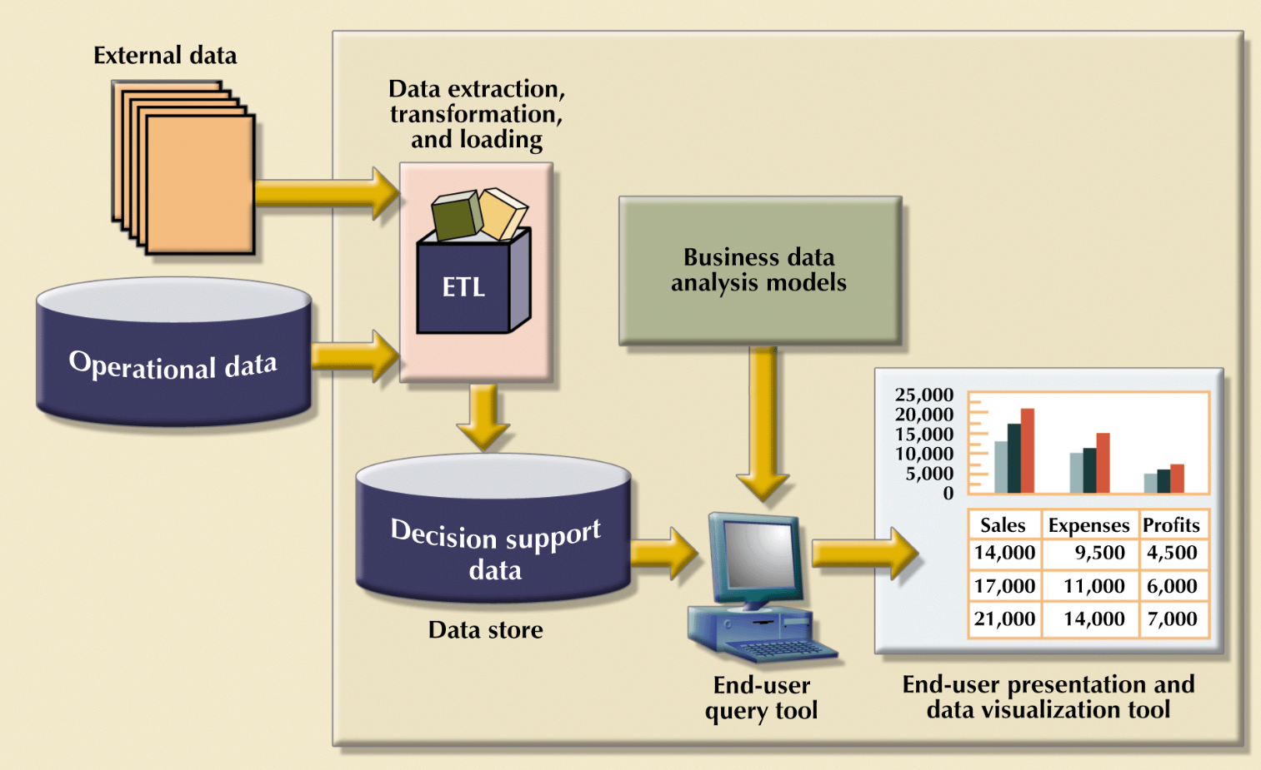
Operational to DSS Transformation
Coronel, Morris, Rob (2011)

Slide 28
Types of Information Systems
Business Intelligence (BI) & Data Science
Data Analytics:
Extracting knowledge from data using mathematical, statistical and modeling techniques, including monitoring, reporting and data visualization.
Decision support system (DSS)
Helps identify decision making opportunities (Whitten, 2007)
Exploratory Analytics & Predictive Analytics
Use pre-existing information, probability, statistics, data mining, artificial intelligence, analytics
Differ from MIS: analyze information rather than just collect, summarize, and display it.
Traditional Example: PageRank to suggest a web site (Google search!)
Complex Example: Trained neural network model to recognize patterns (i.e. predict stock market trends)

Slide 29
Enterprise Information Systems
Customer Relationship Management (CRM)
Customer management: marketing, sales force, contact, contract
How to retain existing customers and accrue new customers.
Communications and Collaboration System (CCS)
Enables more effective communications between workers, partners, customers, and suppliers to enhance their ability to collaborate. (Whitten, 2007)
Example: Email, Chat, Blog, Zoom?
Office Automation System (OAS)
Supports the wide range of business office activities that provide for improved work flow between workers. (Whitten, 2007)
Example: Microsoft Office Suite, Forms Automation
Enterprise Systems (ES) & Enterprise Resource Planning (ERP)
Multiple Integrated Systems
Software application that fully integrates information systems that span most or all of the basic, core business functions. (Whitten, 2007)

Slide 30
Types of Information Systems
Expert System (ES)
Captures the expertise of workers and then simulates that expertise to the benefit of non-experts. (Whitten, 2007)
Difference between DSS is that Expert System is build on expert’s expertise.
Social Networking & Media Services
Connect and share interests, opinions and ideas through various mediums.
Content Streaming Services
Distribution of media content
Smart Home and Vehicular Automation Systems
Automation and control of home and vehicle systems

Slide 31
Information Systems Approach
Build Vs. Buy decision?
Is there a system off the shelf close enough to match enterprise needs? (Can we adapt and shift our process to it?)
If not, do we have enough resources to build and maintain a system that’s customized to our business?
When we develop/customize systems, what should we focus on?
Consider best of breed (focus on a specific function which it does well)
Consider standards when evaluating for systems
Importance of considering Integration
A multi functional Enterprise System (correlates several functions, built in integration, but may lack best of breed features)
How much will all this cost?!?

Slide 32
Week 1 Topic 2
Requirements Analysis
System Requirements
Design
Implementation
Testing
Maintenance

Slide 33
Project Identification
Business need: responding to emerging technology and market trends, to decrease cost or to increase profit.
Support business operations.
Improve process efficiency and adding additional features for usability.
Improve system performance or update technology of existing systems.
Introduce additional control and security to comply with business and government regulations.
Module 1 CS682: Systems Requirements

Slide 34
System Requirements
You can’t do anything useful until you understand what you want or need to get done.
A system requirements specification describes an intended product or set of products. It includes a set of requirements and constraints on software and hardware.
Requirements Analysis is the process of understanding what's wanted or needed in an application.
We express requirements in writing to complete our understanding and to create a contract between developer and stakeholders.
Module 1 CS682: Systems Requirements
Module 3 CS682: The Meaning of “Requirements”

Slide 35
System Analyst Roles
Business Analyst
Identifying business value
Systems Analyst
Focus on information technology
Identify system requirements and design (what the system does) - match business goals.
Infrastructure Analyst
technical infrastructure and design how the system will be implemented within the infrastructure (hardware, software, network, database systems)
Project Manager
Planning the project and insuring that it is completed on time and within allocated resources (i.e. staff, funding) , meets requirements

Slide 36
System Builders
Application Programmers
Write code that implements required system capabilities using high level programming languages or scripting languages
System Programmers
Handle operating system tasks that allow several programs to share computer resources such as memory, disk space, or communications lines
Database Architects and Programmers
Create and implement database designs and database queries
Database Administrators
Ensure security, integrity, and performance of databases
Network and infrastructure architects and administrators, security administrators
Design and implement network, servers and storage systems.
Webmasters & content management specialists

Slide 37
Skills of Systems Analyst
General business knowledge
Good interpersonal communication skills
“Your communication skills, not your technical skills, will prove to be the biggest factor in your carrier success or failure” (Whitten, 2007)
Good interpersonal relations & political skills
Working knowledge of information technology
Problem-solving Analytical skills
Technical experience and expertise
Flexibility and adaptability
Character and ethics
(Whitten, 2007), (Dennis, Wixom and Tegarden, 2015)

Slide 38
Approach to Systems Requirements
System Analyst’s task: to arrange an orderly means for obtaining requirements.
Consider taking a big problem and break it down into small parts.
We will look at more of these next week, including the entire process (waterfall, agile) but today we focus on Requirements Analysis specifically.
But at high level….

Slide 39
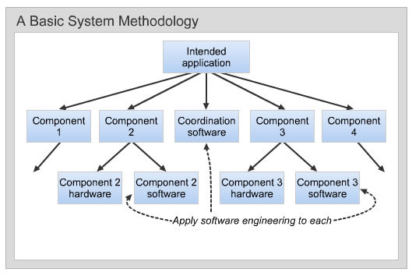
Basic System Methodology
Module 1 CS682: Systems Requirements

Slide 40
Systems Requirements Methodology
Write a Mission Statement/Systems Overview
High level context and scope for the system. (Paragraph)
Develop Functional System Requirements
WHAT it's meant to do
Write System-Level Use Cases
Interactions between system and users
Specify System-Level Quality Requirements
Measurable acceptable quality of the system
Write System-Level Constraints
HOW system is implemented
Conditions that should not be violated
(Module 1 CS682: Systems Analysis Methodology)
The question of how to do systems analysis is the goal of this entire course!

Slide 41
Mission Statement
The mission statement must give a high level context and scope for the system.
Solution should be about a paragraph (4 sentences max)
Don’t forget system name, company name, key users, key functional uses at high level, and it’s purpose.
Be specific to scenario, if need be, show references in Appendix.
Go back to the mission statement after you complete the other parts to check for consistency.
Example not to use: “Secure & user friendly system will help sales staff provide remote insurance quotes.”

Slide 42
Mission Statement Example
quickMessage is a browser-based chat platform for enterprise users. quickMessage allows users to review and manage their contact list and message contacts within the organization. quickMessage uses an intuitive and minimalist design interface and integrates with the organization’s Directory listing for prepopulated contact lists.

Slide 43
Mission Statement Example
quickMessage is a browser-based chat platform for enterprise users. quickMessage allows users to review and manage their contact list and message contacts within the organization. quickMessage uses an intuitive and minimalist design interface and integrates with the organization’s Directory listing for prepopulated contact lists.

Slide 44
Functional Requirements
One sentence, one topic only.
Summary of the functionality, not step by step process (this is a use case).
Expand the mission statement by describing system functionality.
WHAT System DOES: System shall do…
Are these consistent with the mission statement?
Understand Functional Requirements vs. System Constraints/Non Functional Requirements, many students mix these up.
Not HOW (design decisions) for implementing these requirements, these are constraints.
Not the Quality of system (Measurable acceptable) these are non-functional quality requirements
Where do GUI Requirements fit?

Slide 45
Functional Requirements
quickMessage shall allow a Sender to send a message to another user or a group of users within the organization.
quickMessage contact list:
quickMessage shall allow Sender to search for another user
quickMessage shall allow Sender to review a directory contact list by department “groups”.
quickMessage shall allow Sender to create favorite contact list.
quickMessage shall allow Sender to set status such as available or busy.
………

Slide 46
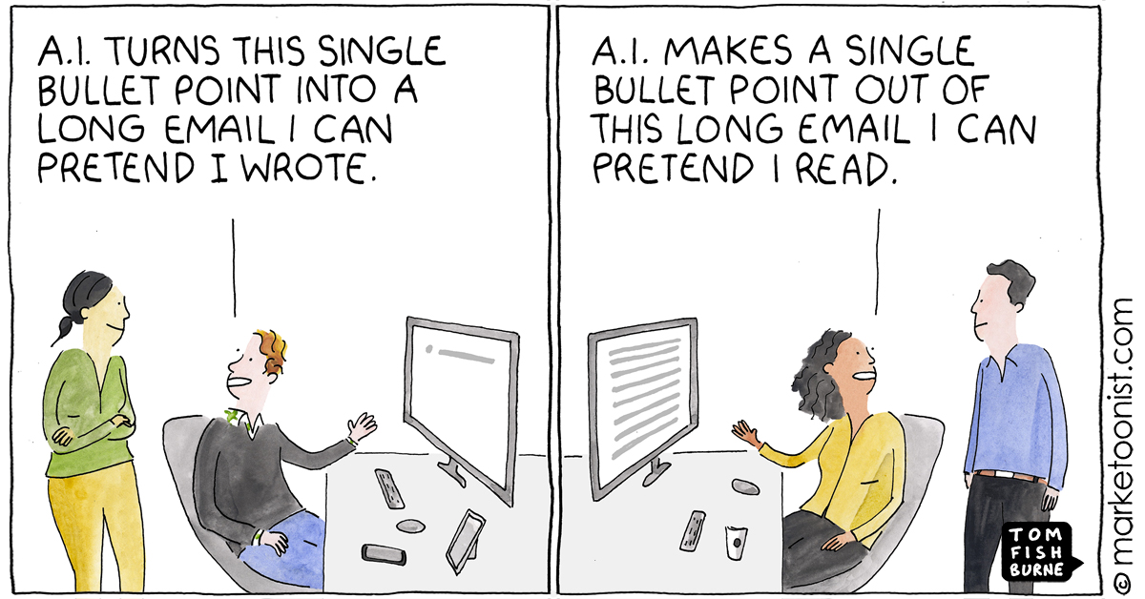
Functional Requirements
How many requirements is enough?
https://marketoonist.com/

Slide 47
System Level Use Cases
Use Case Is a series of steps between a user and system.
A story-like sequence of user actions and system responses.
Use cases are a method for specifying the desired system behavior
System Use Case: This is a very top Level Use Case, try to involve several functional requirements.
Maintain consistency with naming of actors.
You may not be able to show all functionality with a system level use case, just focus on most important ones.
Focus on what you outlined in the mission statement, can you derive 2-3 key system level use cases?

Slide 48
System Level Use Case example:
Actor: | Sender
Description: | This use case shows steps of how quickMessage shall allow a Sender to send a message to another user or a group of users within the organization.
Step # | Actor | System
1 | Sender opens the quickMessage. | quickMessage displays contact list.
2 | Sender selects a contact. | quickMessage displays a chat window with the selected contact.
3 | Sender enters text into the chat window and clicks send. | quickMessage displays entered text by Sender.
4 |  | If contact replied, quickMessage displays reply text from the contact.
Alternate Courses: | (System Alt 4) If contact did not reply, display nothing.

Slide 49
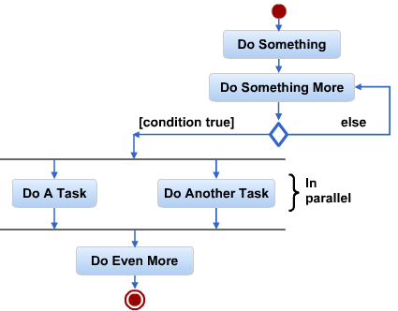
Activity Diagrams
Flowcharts are among the oldest graphical methods to depict process.
The UML uses an extended form of flowcharts called Activity Diagrams.
We will use Activity diagrams to
Visualize requirements at high level (a use case)
Design at detailed level (a method)

Slide 50




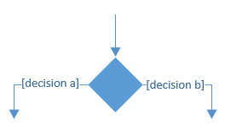
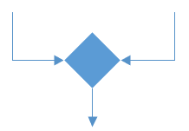
Activity Diagram Components
Term and Definition | Symbol
Activity: A step by the end user or system
Control flow Shows the sequence of execution
Initial Node Beginning of the activities
Final Activity Node End of partitivities
Decision Node Logical condition to depict the flow of activities based on decision Labeled with decision criteria (i.e. True) to continue down a specific path
Merge Node Bring back together different decision paths that where created using a decision node

Slide 51
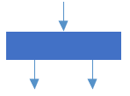
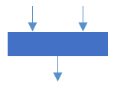
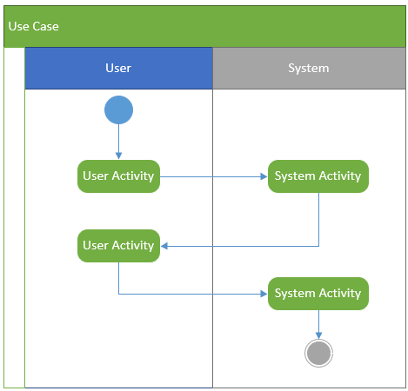
Activity Diagram Components
Term and Definition | Symbol
Fork Node: Split flow into parallel or concurrent flows or activities
Join Node Bring back flow from parallel or concurrent flows or activities
Swimlanes Organize the activity diagram into columns or rows based on who is responsible in performing the activity.

Slide 52
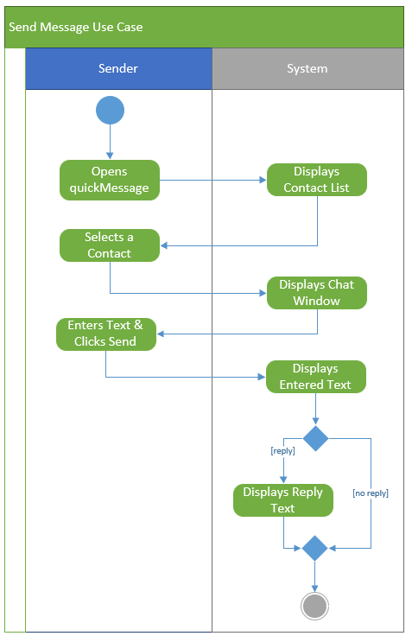
Activity Diagram Example
Actor: | Sender
Description: | This use case shows steps of how quickMessage shall allow a Sender to send a message to another user or a group of users within the organization.
Step # | Actor | System
1 | Sender opens the quickMessage | quickMessage displays contact list.
2 | Sender selects a contact. | quickMessage displays a chat window with the selected contact.
3 | Sender enters text into the chat window and clicks send. | quickMessage displays entered text by Sender.
4 |  | If contact replied, quickMessage displays reply text from the contact.
Alternate Courses: | (System Alt 4) If contact did not reply, display nothing.

Slide 53
Non Functional Requirements:
Quality Requirements: Non-Functional outline the quality of a system- Measurable
Performance, Availability, Data Quality, Ease of Use
Constraints: What, HOW a design decision should be:
Using a particular device, programming language, or encryption method.
Consider:
Responsive Design
Security
Notes on assignment 1:
If your requirement may fall between functional or non-functional, explain your choice for categorization.
If your requirement is a bit vague, consider adding an example within the Appendix section.

Slide 54
Non Functional Requirement Example:
Quality Requirements:
quickMessage messages shall take no more than one second to display in the chat window 95% of the time.
Constraints:
quickMessage functional areas shall be no more than 2 clicks away from the main page.
quickMessage app window shall have a minimum size of 250 pixels wide by 400 high.
quickMessage app shall be implemented using responsive design utilizing html5.
quickMessage app shall be compatible with Chrome v51 and above, Firefox v48 and above.
quickMessage app shall integrate with company Active Directory infrastructure for contact listing.

Slide 55
Main Points….
The most important element of requirements analysis is to capture the NEEDED requirement
Organize requirement clearly and appropriately.
Maintain consistency within the requirements.

Slide 56
How do we know when we have achieved “sufficient” requirements?
Even a genius designer is limited in his ability to visualize a product that has yet to be built.
With your requirements would the application provide the services you want it to provide in how you would like to provide them?

Slide 57
References
Whitten, B. (2007). Systems analysis & design methods. (7th ed.). New York, NY: McGraw-Hill Irwin.
Dennis, A., Wixom, B. H., & Tegarden, D. (2015). Systems Analysis & Design An Object-Oriented Approach with UML (5th ed.). Wiley.
Coronel, Morris, Rob (2011). Database Systems: Design, Implementation & Management. Ninth Edition. Boston: Cengage Learning
Braude, E. & Polnar, J. (2019). Module 1. Retrieved from Boston University Information Systems Analysis and Design Blackboard site.
Warren Mansur’s Guide on References
Zikopoulos, P. (2012). Understanding big data: analytics for enterprise class Hadoop and streaming data. New York: McGraw-Hill.
Paul, J. (2019, October 19). Good Programmer vs Average Programmer - and, Why Asking questions and Paying attention to Details matters. Retrieved from https://dev.to/javinpaul/good-programmers-vs-average-programmer-and-why-asking-questions-and-paying-attention-to-details-matters-j3h.

